Slide 1

PROJECT OVERVIEW
Mirjam Nilsson​

Slide 2
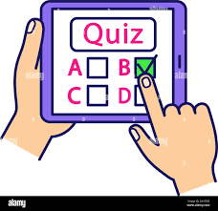
SUBMITTED BY:
SUBJECT:
INTERACTIVE QUIZ
Yashita Prajapati
Roll No. :- 2210990980
Yatin Kalra
Roll No. :- 2210990983
Pulkit Vashisht
Roll No. :- 2210931012
SUBMITTED TO:
Anand Muni Mishra
GROUP 30(AD)

Slide 3
Points Undertaken In Presentation
Acknowledgment
Introduction
Modules used
Advantages/ Disadvantages
Bibliography
Summary
How does it works?
Clip of working of the project

Slide 4
Acknowledgment
We would like to thank Mr. Anand Muni Mishra, our mentor for his support and initial guidance in completing our project. It was a great learning experience.
This initiative would not have been a success without the contributions of each and every individual. We were always there to cheer each other on, and that is what kept us together until the end.
We guarantee that this project was created entirely by us and is not a forgery. Finally, we’d like to express our gratitude to our parents and friends for their excellent comments and guidance during the completion of this project.

Slide 5
Introduction
A quiz is a form of game or mind sport in which players attempt to answer questions correctly about a certain or variety of subjects. Quizzes can be used as a brief assessment in education and similar fields to measure growth in knowledge, abilities, or skills. They can also be televised for entertainment purposes, often in a game show format. In an educational context, a quiz is usually a form of a student assessment, but often has fewer questions of less difficulty and requires less time for completion than a test.
During this pandemic, giving online quizzes was one of ways teaching was done. As we know, young learners can easily get bored and lack focus when they study for long periods of time. In order to cope with this limitation, we have to design fun quizzes for students. Unique features such as power-ups and live dashboard in Quizizz can boost their interest toward the quiz. Furthermore there are several benefits of giving online quizzes for students.

Slide 6
Modules Used
TKINTER :- Tkinter is the standard GUI (graphical user interface) library for Python. Python when combined with Tkinter provides a fast and easy way to create GUI applications. Tkinter provides a powerful object-oriented interface to the Tk GUI toolkit.
from tkinter import* :-
It is a method to import tkinter library to our code which comes with inbuilt methods or functions. We don’t have to explicitly override the method for the widgets.
main() :-
Used to insert the main event loop to take action against each event triggered by the user.

Slide 7
Tkinter Widgets Used
frame :-
The Frame widget was used as a container widget to organize other widgets.
text :-
The Text widget was used to display text in multiple lines.
label :-
The Label widget was used to provide a single-line caption for other widgets.
button :-
The Button widget was used to display buttons for different questions in the quiz.

Slide 8
→ Geometrical Management :
grid() :-
This geometry manager was used to organize widgets in a table-like structure in the parent or main widget.
pack( ) :-
This geometry manager was used to organize widgets in blocks before placing them in the parent or main widget.
→ Standard Attributes :
Dimensions
Colors
Fonts
bg (background color)

Slide 9
How does it works ??
Run the code. A pop up tk window will appear on the screen.
Now attempt the question that appears on the screen.
If your selected answer is correct, the screen will show “CORRECT” and Marks obtained=1
And vica versa if the input i.e. answer to the questions is incorrect, the screen will display “INCORRECT” and Marks Obtained=0
You can change the question no. from the frames present on the ribbon(top of the screen).

Slide 10
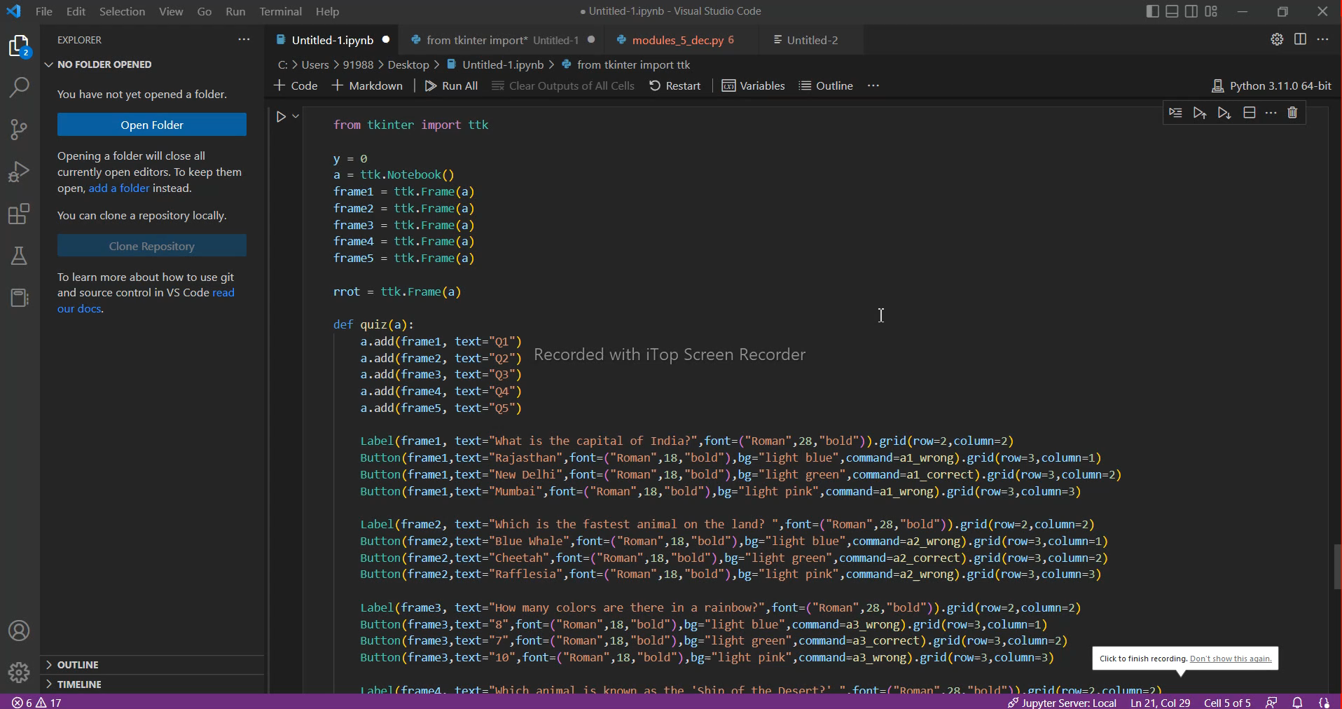
Clip of working of
QUIZ

Slide 11
→ Engage your audience. → A large number of participants. → Randomizing questions. → Quiz results/ gain insight in audience. → No instructor needed
Advantages
Disadvantages
The quiz might be testing a user’s logical and interpretative skills rather than knowledge acquired.
Can restrict insights into how complete an understanding a learner has gained due to the element of chance involved.
Encourage guessing, and reward for correct guesses.

Slide 12
Bibliography
https://www.google.com/search?q=chitkara+university&rlz=1C1ONGR_en&oq=chitkara+university&aqs=chrome..69i57j69i61.6214j0j7&sourceid=chrome&ie=UTF-8#imgrc=TDc02ozqZCKRJM%253A
https://en.wikipedia.org/wiki/Quiz
https://en.wikipedia.org/wiki/Quiz

Slide 13
Thank you
Efforts by:
Yashita Prajapati,
Yatin Kalra,
Pulkit Vashisht

